Slide 1
Newton’s Forward differentiation newton backward differentiation Formula
Course Instructor
Engr. Rahemeen
Rahemeen.bukc@bahria.edu.pk

Slide 2
Newton Forward Differentiation
Forward
Differentiation is a fundamental mathematical concept that involves finding a function’s rate of change or slope concerning one of its independent variables.
It is commonly used to understand how a function behaves and changes over a specific interval.
Newton's Forward Differentiation is a numerical technique employed to estimate the derivative of a function at a specific point, especially when dealing with tabulated data or discrete points.
Newton's Forward Differentiation works:
By taking two closely spaced data points, typically a point of interest and the one just after it.
Calculating the difference in function values between these two points.
The derivative at the specific point is then approximated by dividing this difference by the step size between the data points

Slide 3
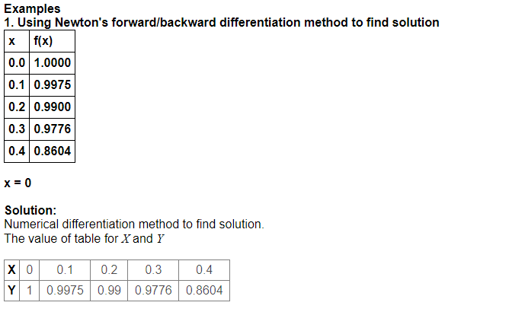
Example 1

Slide 4
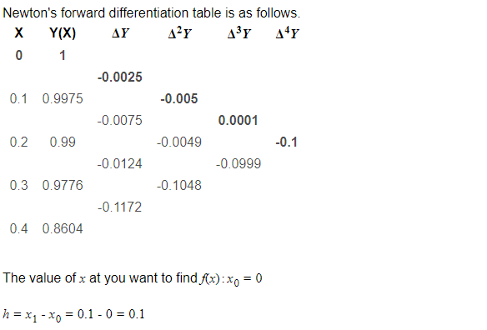

Slide 5
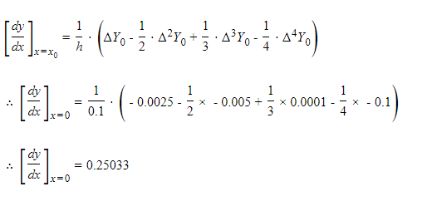


Slide 6
Newton Backward Differentiation
Newton's Forward Differentiation is a numerical technique employed to estimate the derivative of a function at a specific point, especially when dealing with tabulated data or discrete points.
Newton's Forward Differentiation works:
By taking two closely spaced data points, typically a point of interest and the one just before it.
Calculating the difference in function values between these two points.
Backward differentiation formula estimates it using the previous data point

Slide 7
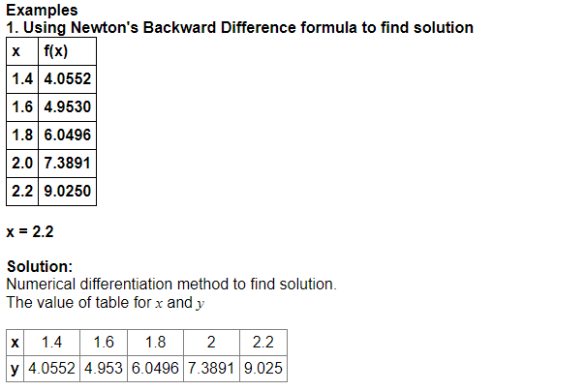

Slide 8
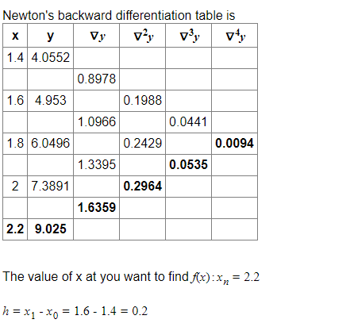

Slide 9
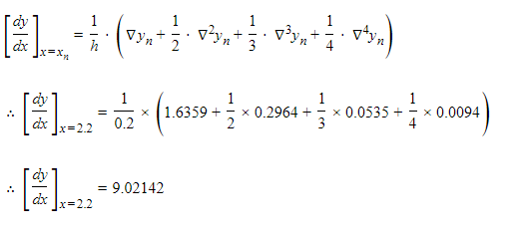


Slide 10
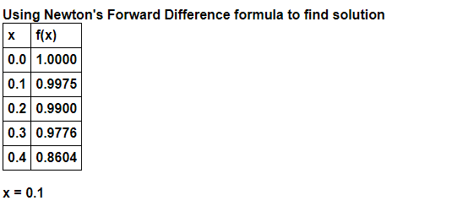
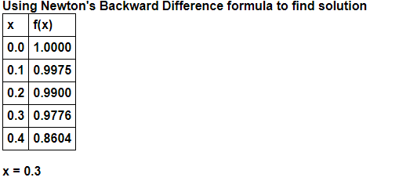
Exercises

